Slide 1
Create your own online portfolio using Github pages Career Development

Slide 2

60 min
Content
Where Are We in the Journey & Learning Objectives
5 min
Agenda for Today
Online portfolios
Hands On
15 min
35 min
Reflections & Takeaways
5 min

Slide 3
Where are we in the learning journey?
Career Development
Leadership Development
Orientation
(1 week)
IU 1.0
Business essentials
(3 weeks)
IU 2.0
Digital essentials
(3 weeks)
Hackathon
(3 weeks)
IU 4.0
Digital Core
(10 weeks)
Capstone
(3 weeks)
IU 4.1 – Ramp up
IU 4.2 – Business analysis for data
IU 4.3 – Databases and querying
IU 4.4 – Visualization and dashboards
IU 4.5 - Statistical Analysis
IU 4.6 – Machine Learning

Slide 4
Learning objectives
Learning how to create an impressive online portfolio to showcase your work
Free personal website hosting
QR code for digital sharing
Linked to Github repository for detailed showcase

Slide 5
Online portfolio

Slide 6


Online portfolio: Guidelines
By looking at your github profile, Interviewers judge the following:
the experience of the candidate(s)
the quality of the work presented using github.
Guidelines:
Put a link to your GitHub in your resume and every application forms you must fill.
The best of your work will be the “landing page”, the first page the employer will see.
Structure/organize your project well with clear titles/name of folders and files,
Classified contents are well appreciated
Have a README file (Coming up next)

Slide 7


Online portfolio: README
README
You can add a README file to your repository as it will be first thing anyone looks at before diving into your work.
Have a README to:
Describe the purpose of the project
Tools, techniques & technologies used in the project
Screenshots/videos
Usage of the project
Link to the installer/webpage

Slide 8

Online portfolio: Projects to showcase
What if I don’t have big projects to show?
Good. Smaller projects are easier to show, easier to explain and easier to understand for the interviewer.
For instance, everyone can grasp a good old Connect Four.
Have practice of adding verified works to github to build up your profile

Slide 9
Online portfolio: A website
We will use GitHub pages to serve the README of your project as a website.
GitHub hosts these websites, so they are free to you.
We will be using markdown¹ to build a portfolio.
After we set up our website, we will use one of the existing themes from Jekyll to give it a more aesthetic feel.
Markdown is a lightweight markup language that you can use to add formatting elements to plaintext text documents Refer this link

Slide 10
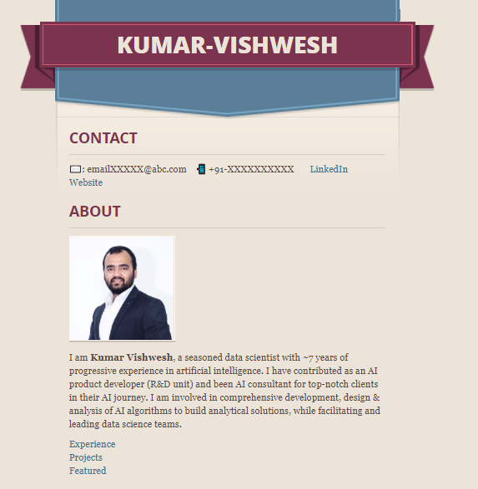
A sample portfolio
https://<github-user-name>.github.io/<your-name>

Slide 11
Exercise: Create an online portfolio
Steps to follow
Time: 35 mins
1
Create a new GitHub repo
2
Click the repo settings tab at the far right of the list & scroll down to the GitHub Pages section
3
Switch the source from None to master branch or main
4
Click the link at the top of the GitHub pages section to go to your new website
5
Copy the template and paste it to your README.md
6
Edit the template & preview the changes
Follow along with me

Slide 12
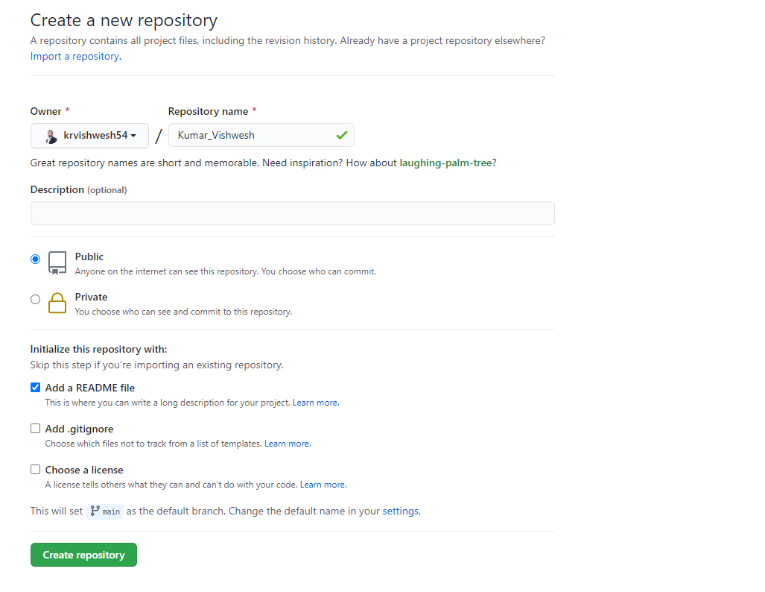
1. Create a new GitHub repo
Name of the repository <Your-Name>
Select repository as Public
Check this option to have README file

Slide 13
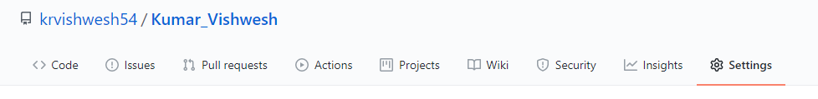
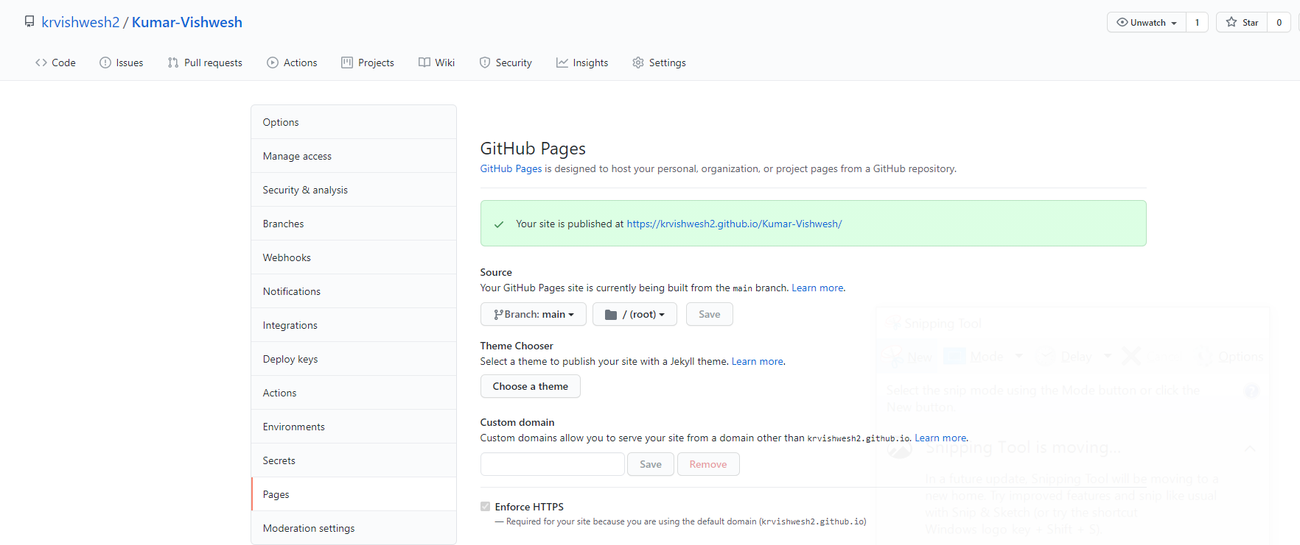
2. Click the repo settings tab at the far right of the list & navigate to pages
Click on settings
Click on Pages

Slide 14
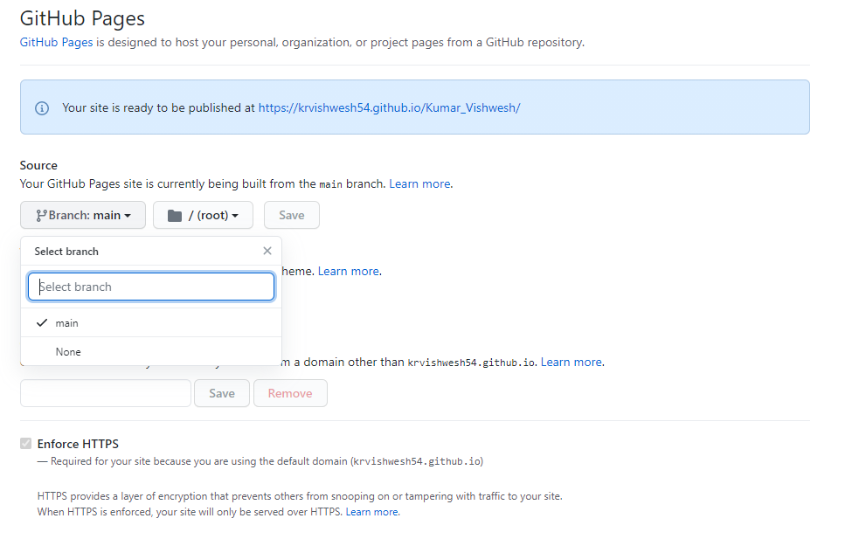
3. Switch the source from None to master branch or main
Change branch to main

Slide 15
4. Click the link at the top of the GitHub pages section to go to your new website
Once the branch is changed to main, you can access your website through this URL
The web page should show the contents of the README.md of your repo.
Congrats! you already have a working website.
If you are getting a 404 error, don’t worry. Sometimes it takes a little bit of time for the server set up

Slide 16
5. Copy the template and paste it to your README.md
Follow the link below and copy the content to Your README.md file
https://raw.githubusercontent.com/krvishwesh54/Kumar-Vishwesh/main/README.md
Once you have saved README, your URL will start hosting the copied content

Slide 17
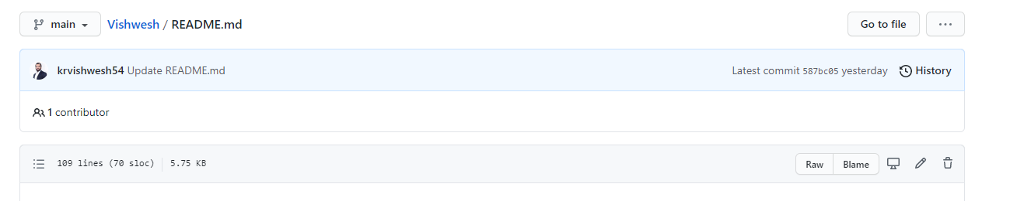
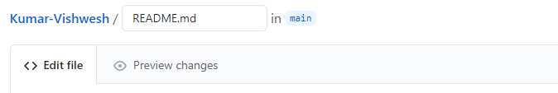
6. Edit the template & preview the changes
Navigate to README file and click on edit icon
Click the edit icon to start editing
While editing you can also preview changes
Preview changes by clicking here

Slide 18
Online Portfolio: Guidelines on how to edit the sections of your portfolio

Slide 19
Online Portfolio: Sections
In the template provided, we have six sections:
Contact
Your contact details, Online Profile like Linkedin etc.
About
A crisp introduction showcasing your gained expertise and roles played (aspiring roles)
Experience
Professional Experience
Education
Educational Qualification
Projects
Links to your projects with supporting headline, image etc.
Featured
List out certifications, achievements etc.

Slide 20
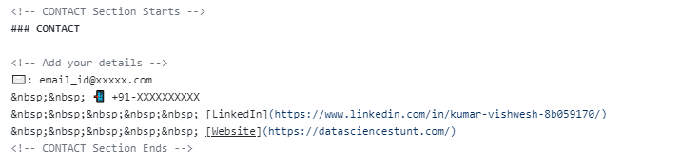
CONTACT
### is to control size of the text
Add your details
&nbsp is to provide inline space
Format to add link

Slide 21
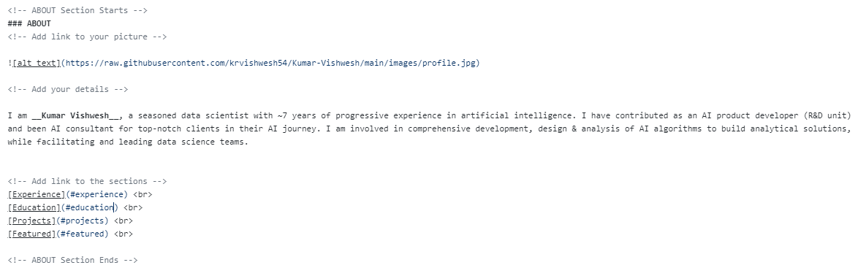
Add URL to your image
Add your details here
ABOUT
Add links to your sections to be created
If you do not have URL of your image, you need to create a separate images folder in your github repository and upload images there.
Then you can get raw github URL that you can provide here in the layout.

Slide 22
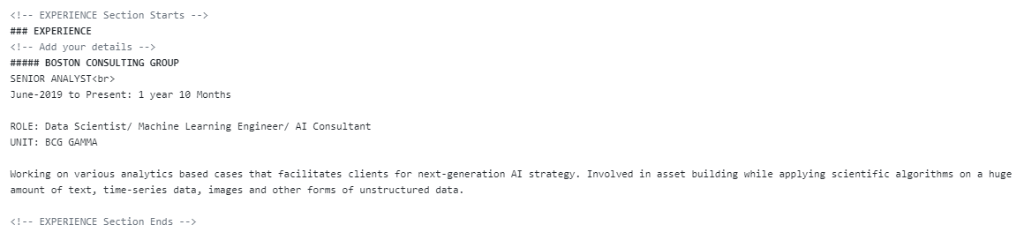
Add your details here
EXPERIENCE

Slide 23
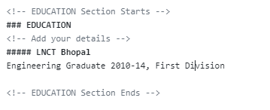
Add your details here
EDUCATION

Slide 24
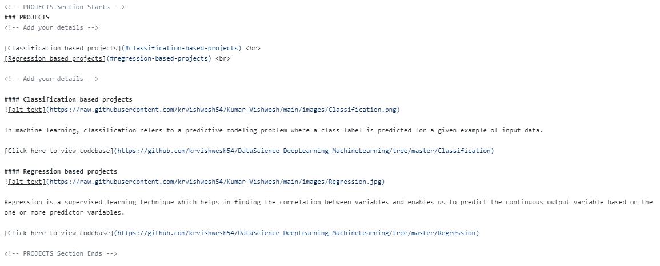
Link to your projects
Add your details here
Link to image
PROJECTS

Slide 25
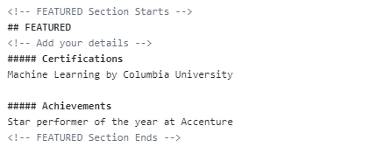
Add your details here
FEATURED

Slide 26
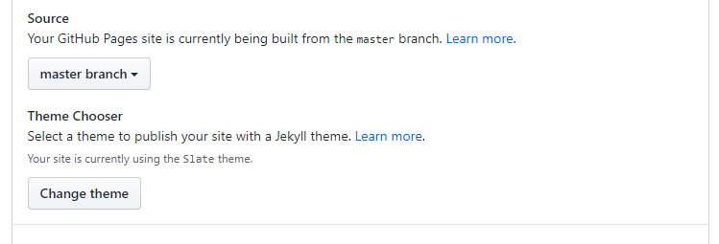
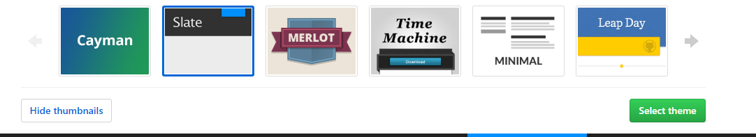
Choose a theme
To do this, you click on the repo settings button again and return to the Github Pages setting box.

Slide 27
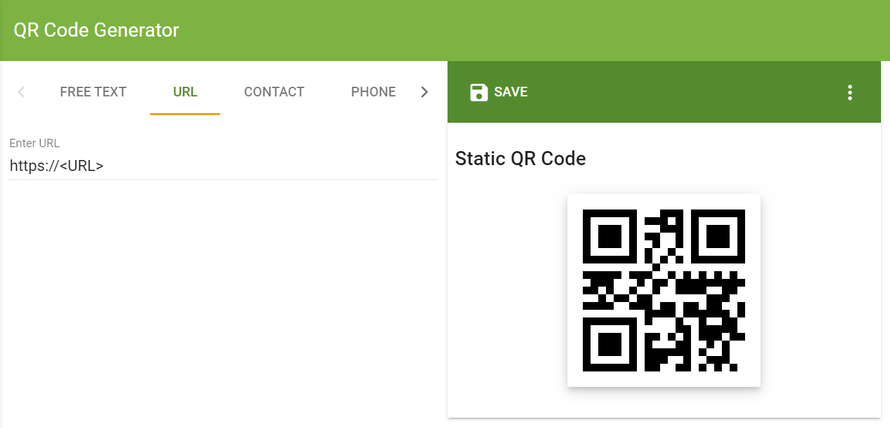
Create QR code
Generate QR code through URL: https://www.the-qrcode-generator.com/ using your portfolio URL.
This generated QR code can be used on your hard copy of your resume/CV so that it redirects your online portfolio post scanning.

Slide 28
Where to go from here?
Other Resources
We have used markdown template to create online portfolio. You can further explore this resource as it uses html templates to create online portfolio.
https://www.geeksforgeeks.org/how-to-build-portfolio-website-and-host-it-on-github-pages/

